Slide 1

Data Analytics for Professional Accountants
ACCTG 522

Slide 2




A little bit about me
My name is Asher
I’m one of six EYARC Academic Fellows
I am here to help you learn data analytics and emerging technology!

Slide 3
Celebrating our differences
Each team member shares something potentially unique about themselves, if that is a unique fact, add it to the list of unique items on pollEverywhere.

Slide 4
Agenda

Slide 5






The Analytical Mindset
The Innovation Mindset
Professionalism
Adaptability & Resilience
The Questioning Mindset
Teamwork & Communication
Notes:
Intro myself. Goal: Best faculty and curriculum. Transition with: Why is dynamic curriculum so important?

Slide 6

Ask the right questions
Gain familiarity with data analytics tools
Understand data characteristics and relevance
The Analytical Mindset
Understand the purpose of different data analytics for different cases
Understand the flow of data through accounting systems
Capture or know how to capture data

Slide 7



Educational Partners
Advisory Board

Slide 8
Syllabus
https://www.ashercurtis.me/teaching/courses/acctg522/syllabus.html

Slide 9
Review and ETL Overview

Slide 10
The Analytical Mindset
The Analytical Mindset is defined as the ability to work with data to apply appropriate analytics and interpret and share insight with stakeholders.

Slide 11

Why do we care about Data Quality?
Analytics quality (and insight) is driven by data quality.
Garbage in = Garbage Out !
This Photo by Unknown Author is licensed under CC BY-ND

Slide 12
Why do we care about Extract, Transform & Load (ETL)?
The Extract, Transform & Load or ETL Process is the first task required to complete the analytical process.
In most cases, data required for the analytical process is stored in a database and must be extracted from that database and loaded into analytics software.

Slide 13
Why do we care about Extract, Transform & Load (ETL)?
In most cases, the data will also have to be transformed, or modified to apply analytics tools
this can include calculating additional variables (like multiplying price and quantity to get sales),
cleaning the data due to differences in formatting,
preparing and joining datasets,
and transposing or pivoting the data.

Slide 14
Identifying data issues
See website for cases (background and today)
https://www.ashercurtis.me/teaching/courses/acctg522/class01.html
There are 9 data quality issues with the file:
Identify the issues and why
Propose how they could be solved

Slide 15
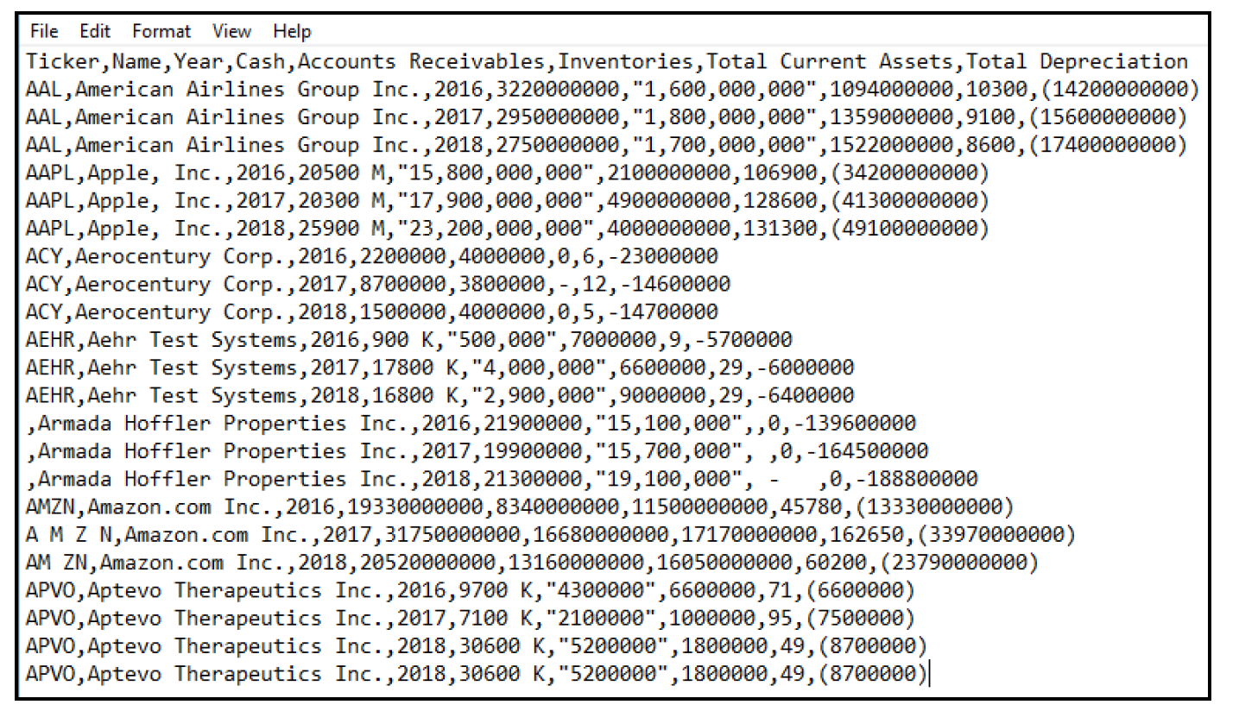

Slide 16
Notes:
Apple has a comma in its name, Apple, Inc., but the name does not have a text qualifier.
Armada Hoffler Properties Inc. is missing the ticker symbol.
The ticker for Amazon.com Inc. (AMZN) has spaces in some instances, but not in others.
Aptevo Therapeutics Inc. has a duplicate row of information.
For the Cash category:
Apple, Inc.’s cash is listed in millions using a number, followed by a space and an M.
Aehr Test Systems’ cash is listed in thousands using a number, followed by a space and a K.
Aptevo Therapeutics Inc.’s cash is listed in thousands using a number, followed by a space and a K.
For Accounts Receivables, some amounts are shown as text and include commas in the number (commas within a text qualifier are appropriate, but this is important to note for purposes of loading the data).
For Inventories, null values are displayed in various forms as text, including a zero, a blank, a hyphen (-), a hyphen with spaces or a space.
For Total Current Assets, none of the amounts are listed in millions.
For Depreciation, some numbers use parentheses for credits (or negatives) and others use a minus sign.

Slide 17
ETL Cases in the FSB Remote Labs
https://fprod-hcs.foster.uw.edu/

Slide 18
In the U Drive of FSB Remote Labs, clone the repo:
git clone https://github.com/ashercurtis/datasets.io

Slide 19
Conclusion
This course is aimed at advancing the analytical mindset and skill set practically.

Slide 20

Before next class checklist:
Check in with canvas:
Read the background reading
Cases are a very short read

Slide 21

Thank You and Congrats!

